Slide 1
Showroom management system
Thejineaswar Guhan : 19BIT0408
PROJECT REVIEW
ITE1003 – DATABASE MANAGEMENT SYSTEMS

Slide 2
Functionality
Multiple views achieved. One for employee other for manager
Manager can allot salary and commission to employee
Inventory management – updation, deletion, insertion and view
Sales addition and view
Customer signup

Slide 3
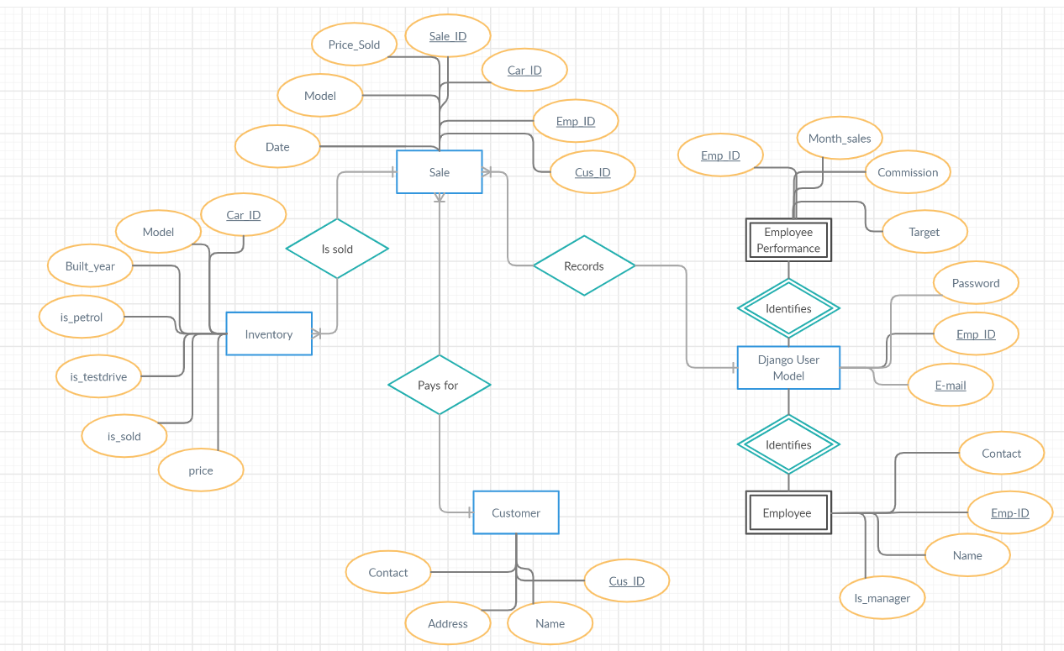
ER diagram

Slide 4
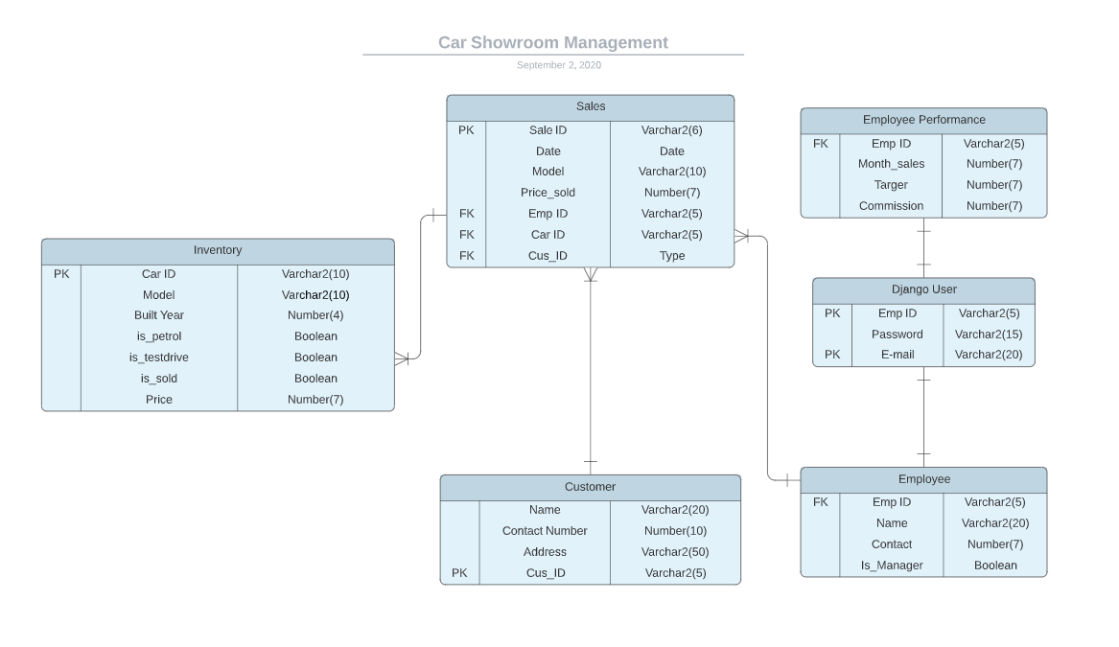
UML Diagram

